Slide 1
Chapter 2
Matrix algebra

Slide 2
Introduction
web1 web2 web3
Web1 1 2 3
Web2 2 2 1
Web3 2 1 1
A
(3, 5)
•
(2, 3)
•
•
0 5 2 4 3
0 0 3 3 5
(4, 3)
•
•
(0, 0)
(5, 0)

Slide 3
OUR GOAL
Matrices
Special matrices
Operations on matrices:
Addition
Difference
Transposition
Scalar multiplication
Matrix multiplication
Inverse of a square matrix
Matrices and linear systems of equations
Matrices and linear transformations

Slide 4
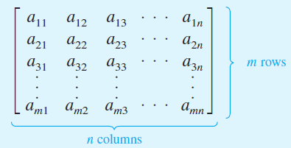
Definition
An mxn matrix is rectangular array of numbers
(m x n): size of the matrix
A = [a_{ij}] // a_{ij} is called (i, j)-entry

Slide 5
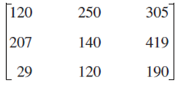

Matrices - examples
An 2x3 matrix // 2 rows, 3 columns
Read: two by three matrix
(1,3)-entry
a[1,3] = 1/2
a₁₃ = 1/2
7 -3 1/2
A =
3 -5 0
3 x 3matrix,
a square matrix
3 x 1 matrix
column matrix

Slide 6
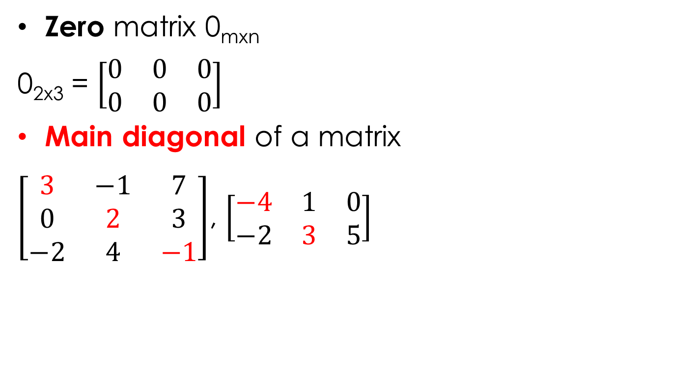
Special matrices
Zero matrix 0_{mxn}
0_{2x3} = $\left[\begin{matrix}0 & 0 & 0 \\ 0 & 0 & 0\end{matrix}\right]$
Main diagonal of a matrix
$\left[\begin{matrix}3 & −1 & 7 \\ 0 & 2 & 3 \\ −2 & 4 & −1\end{matrix}\right]$, $\left[\begin{matrix}−4 & 1 & 0 \\ −2 & 3 & 5\end{matrix}\right]$

Slide 7
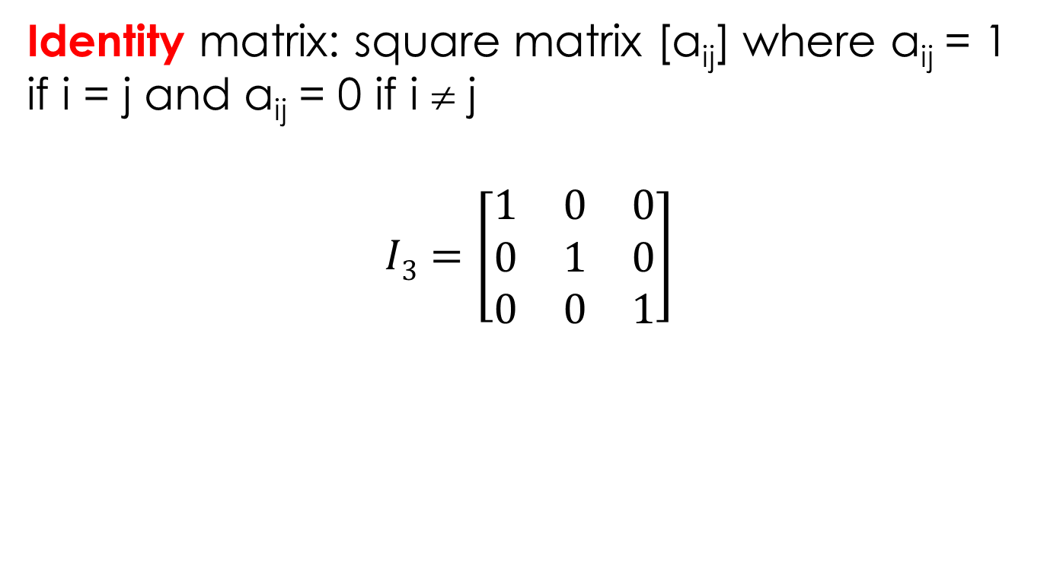
Identity matrices
Identity matrix: square matrix [a_{ij}] where a_{ij} = 1 if i = j and a_{ij} = 0 if i ≠ j
$$I3=\left[\begin{matrix}1 & 0 & 0 \\ 0 & 1 & 0 \\ 0 & 0 & 1\end{matrix}\right]$$

Slide 8
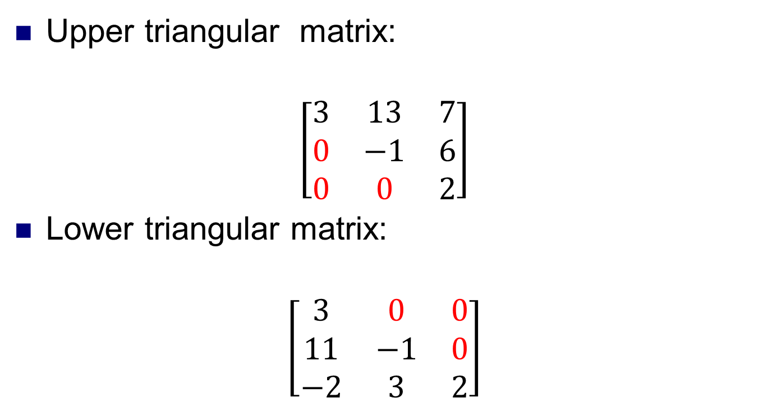
Triangular matrices
Upper triangular matrix:
$$\left[\begin{matrix}3 & 13 & 7 \\ 0 & −1 & 6 \\ 0 & 0 & 2\end{matrix}\right]$$
Lower triangular matrix:
$$\left[\begin{matrix}3 & 0 & 0 \\ 11 & −1 & 0 \\ −2 & 3 & 2\end{matrix}\right]$$

Slide 9
Transpose of a matrix
mother | Bob | Alice | Minh | Nam
Eva | 0 | 1 | 0 | 0
Susan | 1 | 0 | 0 | 0
Lan | 0 | 0 | 1 | 1
son/daughter | Eva | Susan | Lan
Bob | 0 | 1 | 0
Alice | 1 | 0 | 0
Minh | 0 | 0 | 1
Nam | 0 | 0 | 1

Slide 10
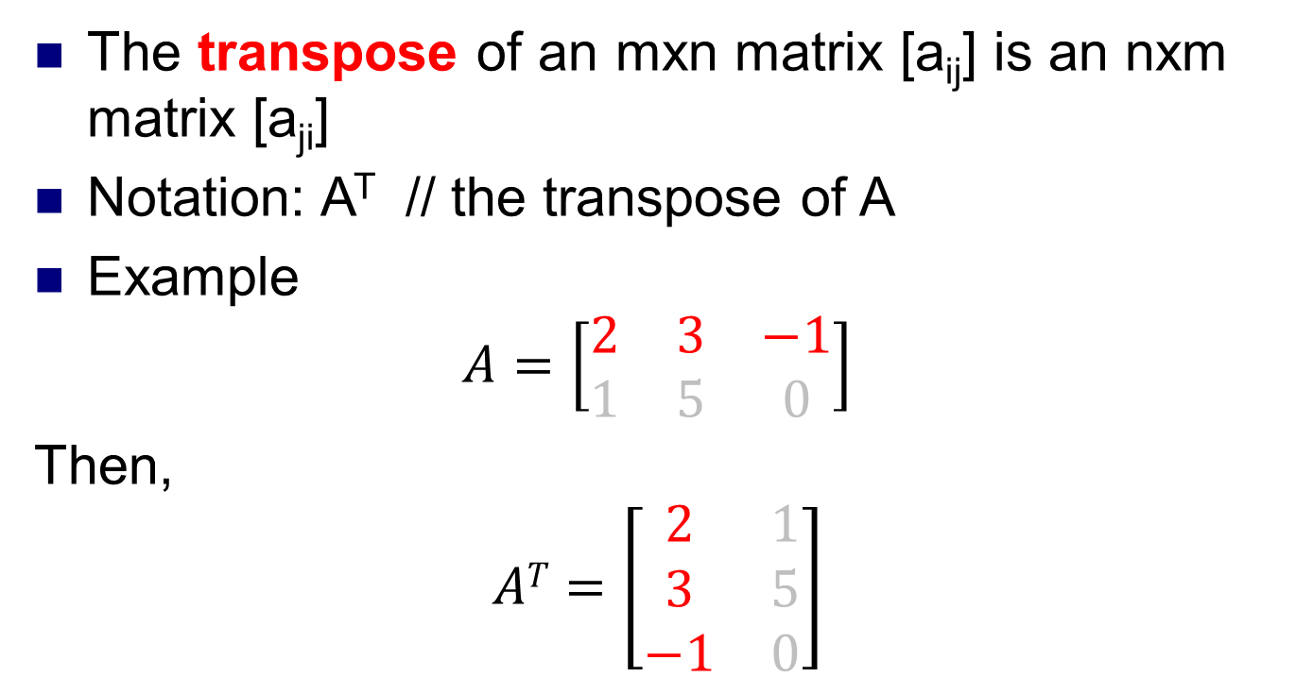
Transpose of a matrix
The transpose of an mxn matrix [a_{ij}] is an nxm matrix [a_{ji}]
Notation: A^{T} // the transpose of A
Example
$$A=\left[\begin{matrix}2 & 3 & −1 \\ 1 & 5 & 0\end{matrix}\right]$$
Then,
$$AT=\left[\begin{matrix}2 & 1 \\ 3 & 5 \\ −1 & 0\end{matrix}\right]$$

Slide 11
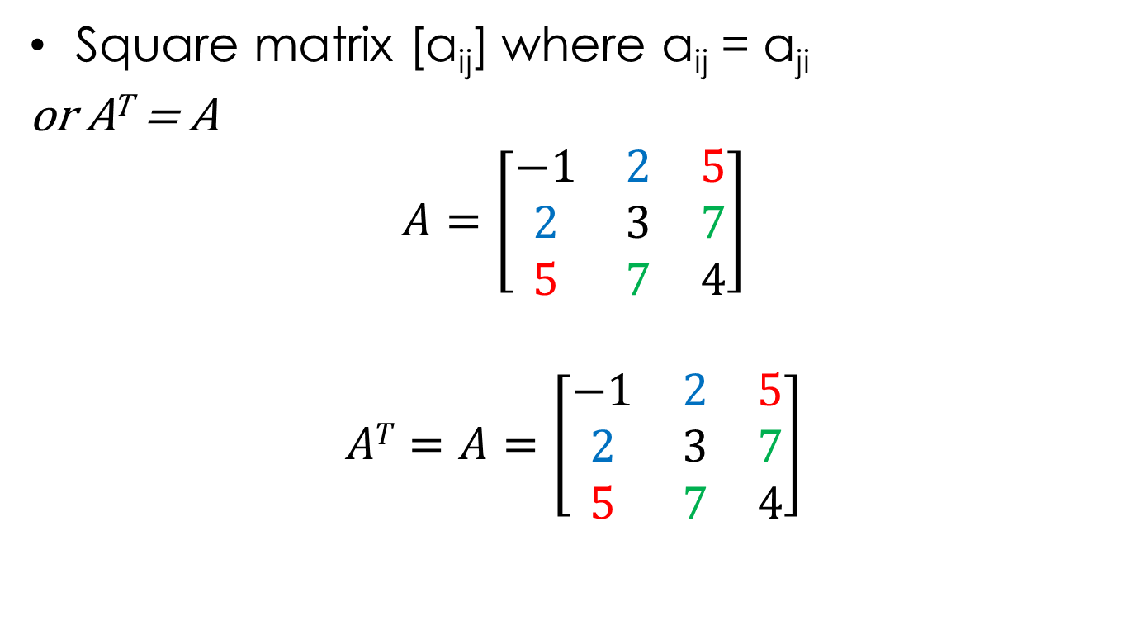
Symmetric matrices
Square matrix [a_{ij}] where a_{ij} = a_{ji}
or A^{T} = A
$$A=\left[\begin{matrix}−1 & 2 & 5 \\ 2 & 3 & 7 \\ 5 & 7 & 4\end{matrix}\right]$$
$$AT=A=\left[\begin{matrix}−1 & 2 & 5 \\ 2 & 3 & 7 \\ 5 & 7 & 4\end{matrix}\right]$$

Slide 12
operations on matrices
The same size
matrices
Addition A + B = [a_{ij} + b_{ij}]
Difference A – B = [a_{ij} – b_{ij}]
Scalar multiplication
Matrix multiplication

Slide 13
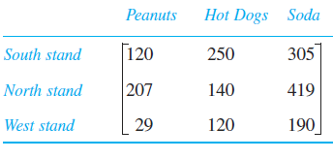

Addition. Difference Scalar multiplication
addition
difference
day 1
day 2
day 1 + day 2?
day 1 – day 2?
2(day 1)?
Scalar multiplication
$$\left[\begin{matrix}110 & 230 & 280 \\ 300 & 155 & 389 \\ 35 & 117 & 201\end{matrix}\right]$$

Slide 14
Properties
Suppose A, B, C are mxn matrices, k is a number:
A + B = B + A // commutative law
A + (B + C) = (A + B) + C // associative law
k(A + B) = kA + kB // distributive law
(A + B)^{T} = A^{T} + B^{T}

Slide 15
Matrix multiplication - introduction
 | peanuts | soda | hot dogs
group A | 8 | 5 | 12
group B | 15 | 7 | 13
selling price | store 1 | store 2 | store 3 | store 4
peanuts | 2 | 2.5 | 2 | 2.5
soda | 2.5 | 2 | 2.75 | 2
hot dogs | 3 | 3 | 2.5 | 3
8x2.5 + 5x2 + 12x3 = 66$
 | store 1 | store 2 | store 3 | store 4
group A | 64.5 | 66 | 59.75 | 66
group B | 86.5 | 87.5 | 81.75 | 90.5

Slide 16
Matrix multiplication
A_{m × n} . B_{n × p} = C_{m × p} //suitable size
The entry c_{ij} = (row i of A).(column j of B)
1.1+2.1
3
4
1
2
3
4
1
2
-1
-2
-1
0
-1
-2
-1
0
-2
0
2
-2
0
2
-4

Slide 17
Properties
A(B + C) = AB + AC //distributive law
A(BC) = (AB)C //associative law
(AB)^{T} = B^{T}A^{T}
Note:
In general, AB ≠ BA ➔ Not commutative
AB = 0  A = 0 or B = 0
AB =AC  B = C

Slide 18

Example
(3, 5)
A
•
(2, 3)
•
•
0 5 2 4 3
0 0 3 3 5
(4, 3)
•
•
D=
(0, 0)
(5, 0)
A
•
Let A = $\left(\begin{matrix}2 & 0 \\ 0 & 2\end{matrix}\right), find AD.$
•
•
0 10 4 8 6
0 0 6 6 10
•
•

Slide 19
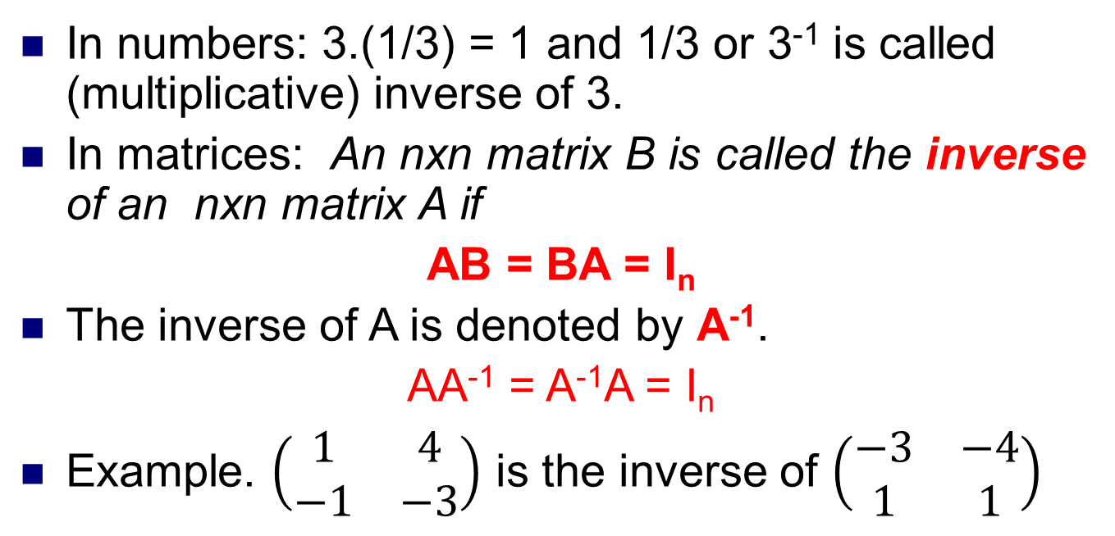
The inverse of a matrix
In numbers: 3.(1/3) = 1 and 1/3 or 3⁻¹ is called (multiplicative) inverse of 3.
In matrices: An nxn matrix B is called the inverse of an nxn matrix A if
AB = BA = I_{n}
The inverse of A is denoted by A⁻¹.
AA⁻¹ = A⁻¹A = I_{n}
Example. $\left(\begin{matrix}1 & 4 \\ −1 & −3\end{matrix}\right)$ is the inverse of $\left(\begin{matrix}−3 & −4 \\ 1 & 1\end{matrix}\right)$

Slide 20
Example

Slide 21
The inverse of 2x2 matrices
A =
A⁻¹ =
2 -3
1 -4
1
-4
3
-5
-1
2
-4.2 – 3.(-1) = -5
// determinant of A, denoted by det(A)

Slide 22
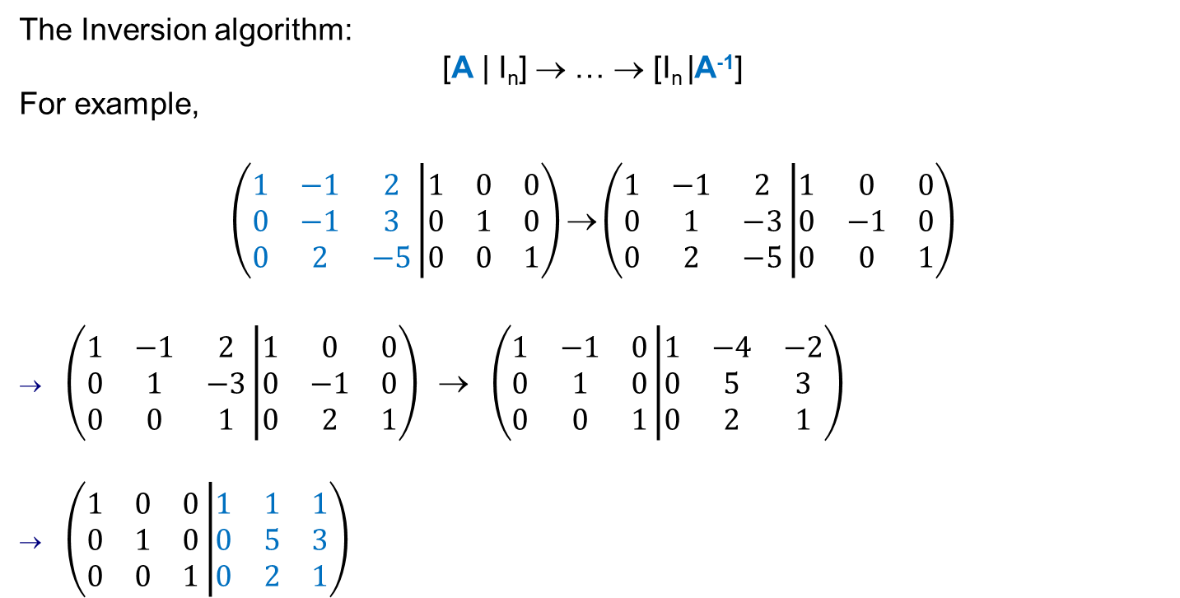
The inverse of nxn matrices
The Inversion algorithm:
[A | I_{n}] → … → [I_{n} |A⁻¹]
For example,
$$\left(\begin{matrix}1 & −1 & 2 \\ 0 & −1 & 3 \\ 0 & 2 & −5\end{matrix}\left|\begin{matrix}1 & 0 & 0 \\ 0 & 1 & 0 \\ 0 & 0 & 1\end{matrix}\right.\right)\text{→}\left(\begin{matrix}1 & −1 & 2 \\ 0 & 1 & −3 \\ 0 & 2 & −5\end{matrix}\left|\begin{matrix}1 & 0 & 0 \\ 0 & −1 & 0 \\ 0 & 0 & 1\end{matrix}\right.\right)$$
$\left(\begin{matrix}1 & −1 & 2 \\ 0 & 1 & −3 \\ 0 & 0 & 1\end{matrix}\left|\begin{matrix}1 & 0 & 0 \\ 0 & −1 & 0 \\ 0 & 2 & 1\end{matrix}\right.\right) \text{→} \left(\begin{matrix}1 & −1 & 0 \\ 0 & 1 & 0 \\ 0 & 0 & 1\end{matrix}\left|\begin{matrix}1 & −4 & −2 \\ 0 & 5 & 3 \\ 0 & 2 & 1\end{matrix}\right.\right)$
$\left(\begin{matrix}1 & 0 & 0 \\ 0 & 1 & 0 \\ 0 & 0 & 1\end{matrix}\left|\begin{matrix}1 & 1 & 1 \\ 0 & 5 & 3 \\ 0 & 2 & 1\end{matrix}\right.\right)$
A
-r₂
-2r₂ + r₃
-2r₃ + r₁
3r₃+ r₂
A⁻¹

Slide 23
Properties of Inverses

Slide 25

Linear equation and matrix multiplication
$$\left(\begin{matrix}−2 & 1 \\ 3 & −2\end{matrix}\right)\left(\begin{matrix}x \\ y\end{matrix}\right)=\left(\begin{matrix}−1 \\ 5\end{matrix}\right)$$
A X = B
$$\left(\begin{matrix}\text{−}\text{2}\text{x}\text{ + }\text{y} \\ 3x−2y\end{matrix}\right)=\left(\begin{matrix}−1 \\ 5\end{matrix}\right)$$
-2x + y = -1
3x -2y = 5
AX = B
X = A⁻¹B
X = $\left(\begin{matrix}−2 & −1 \\ −3 & −2\end{matrix}\right)\left(\begin{matrix}−1 \\ 5\end{matrix}\right)=\left(\begin{matrix}−3 \\ −7\end{matrix}\right)$ ➔ x = -3, y = -7

Slide 26
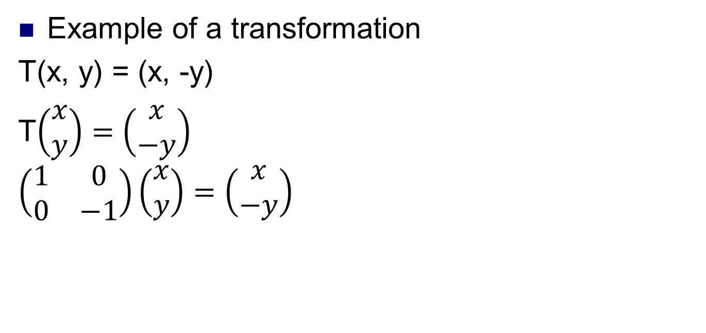
Matrix and linear transformation
Example of a transformation
T(x, y) = (x, -y)
T$\left(\begin{matrix}x \\ y\end{matrix}\right)=\left(\begin{matrix}x \\ −y\end{matrix}\right)$
$$\left(\begin{matrix}1 & 0 \\ 0 & −1\end{matrix}\right)\left(\begin{matrix}x \\ y\end{matrix}\right)=\left(\begin{matrix}x \\ −y\end{matrix}\right)$$
y
input
• (x, y)
x
• (x, -y)
output
input
output
Matrix of
The transformation

Slide 27
Matrix and linear transformation
Example of a transformation
S(x, y) = ?
Find the matrix of S?
y
input
• (x, y)
x
(-x, -y) •
output

Slide 28
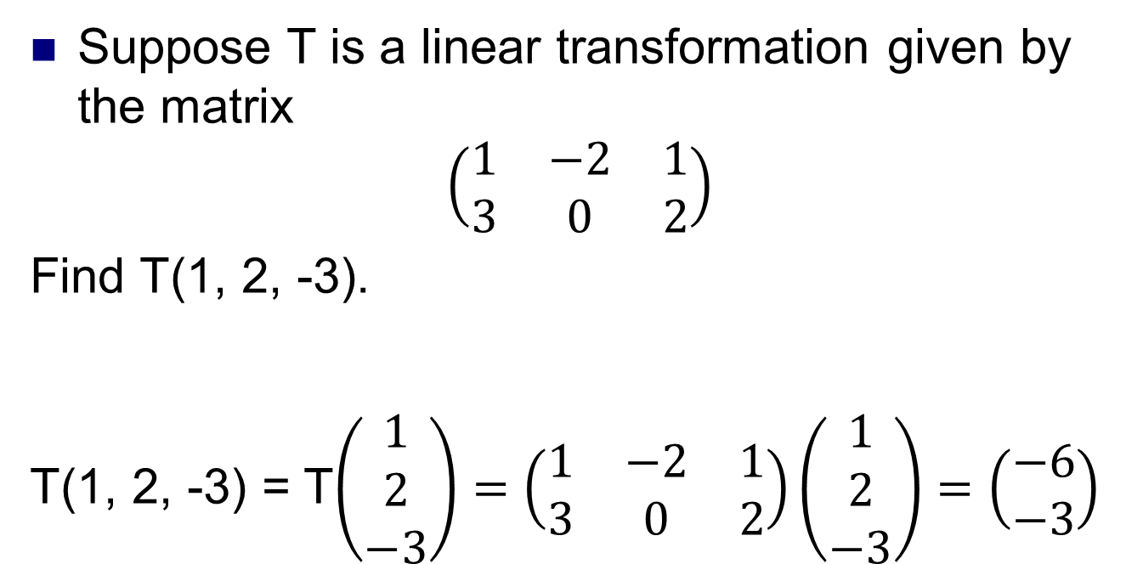
Suppose T is a linear transformation given by the matrix
$$\left(\begin{matrix}1 & −2 & 1 \\ 3 & 0 & 2\end{matrix}\right)$$
Find T(1, 2, -3).
T(1, 2, -3) = T$\left(\begin{matrix}1 \\ 2 \\ −3\end{matrix}\right)=\left(\begin{matrix}1 & −2 & 1 \\ 3 & 0 & 2\end{matrix}\right)\left(\begin{matrix}1 \\ 2 \\ −3\end{matrix}\right)=\left(\begin{matrix}−6 \\ −3\end{matrix}\right)$

Slide 29
Definition
A transformation T : Rn →Rm is called a linear transformation if it satisfies the following two conditions for all vectors x and y in Rn and all scalars a:
T1 T(x+y) = T(x)+T(y)
T2 T(ax) = aT(x)
Example

Slide 30

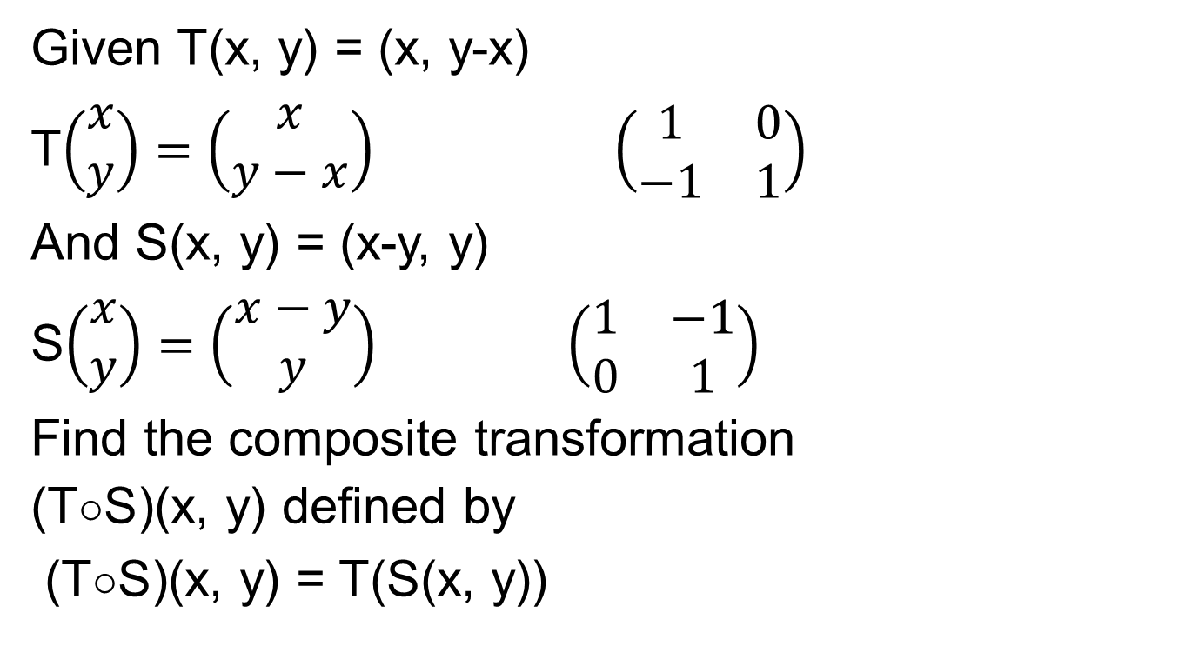
The composition of transformations
Given T(x, y) = (x, y-x)
T$\left(\begin{matrix}x \\ y\end{matrix}\right)=\left(\begin{matrix}x \\ y−x\end{matrix}\right)$ $\left(\begin{matrix}1 & 0 \\ −1 & 1\end{matrix}\right)$
And S(x, y) = (x-y, y)
S$\left(\begin{matrix}x \\ y\end{matrix}\right)=\left(\begin{matrix}x−y \\ y\end{matrix}\right)$ $\left(\begin{matrix}1 & −1 \\ 0 & 1\end{matrix}\right)$
Find the composite transformation
(T□S)(x, y) defined by
(T□S)(x, y) = T(S(x, y))
Matrix of T □ S:
$\left(\begin{matrix}1 & 0 \\ −1 & 1\end{matrix}\right)$ $\left(\begin{matrix}1 & −1 \\ 0 & 1\end{matrix}\right)$
= $\left(\begin{matrix}1 & −1 \\ −1 & 2\end{matrix}\right)$
➔ (T □ S)$\left(\begin{matrix}x \\ y\end{matrix}\right)=\left(\begin{matrix}x−y \\ −x+2y\end{matrix}\right)$

Slide 31
The inverse of a transformation - introduction
transformation
Message
encode
Encoded mess
Message
decode
Encoded mess
Inverse transformation

Slide 32
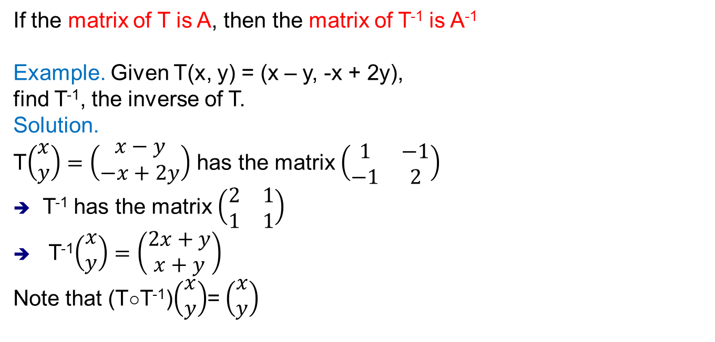
Theorem
If the matrix of T is A, then the matrix of T⁻¹ is A⁻¹
Example. Given T(x, y) = (x – y, -x + 2y),
find T⁻¹, the inverse of T.
Solution.
T$\left(\begin{matrix}x \\ y\end{matrix}\right)=\left(\begin{matrix}x−y \\ −x+2y\end{matrix}\right)$ has the matrix $\left(\begin{matrix}1 & −1 \\ −1 & 2\end{matrix}\right)$
T⁻¹ has the matrix $\left(\begin{matrix}2 & 1 \\ 1 & 1\end{matrix}\right)$
T⁻¹$\left(\begin{matrix}x \\ y\end{matrix}\right)=\left(\begin{matrix}2x+y \\ x+y\end{matrix}\right)$
Note that (T□T⁻¹)$\left(\begin{matrix}x \\ y\end{matrix}\right)$= $\left(\begin{matrix}x \\ y\end{matrix}\right)$

Slide 33
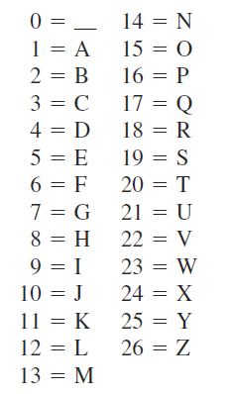

The inverse of a transformation
Example in cryptography
Encrypt the message STOP
by the transformation T(x, y) = (x - 3y, -x + 4y)
S T O P
19 20 15 16
$D=\left(\begin{matrix}19 & 20 \\ 15 & 16\end{matrix}\right)$
T(x, y) = (x - 3y, -x + 4y)
Matrix of T, M = $\left(\begin{matrix}1 & −3 \\ −1 & 4\end{matrix}\right)$
Encryption:
MD = $\left(\begin{matrix}1 & −3 \\ −1 & 4\end{matrix}\right)\left(\begin{matrix}19 & 20 \\ 15 & 16\end{matrix}\right)=\left(\begin{matrix}−26 & −28 \\ 41 & 44\end{matrix}\right)=D′$
message: -26 -28 41 44
Decryption: from D’ find D and the inverse of M
Note that MD = D’ ➔ D = M⁻¹D’

Slide 42
Thanks

